Slide 1

ISO 27001 (ISMS) & ISO 27701 (PIMS)

Slide 2
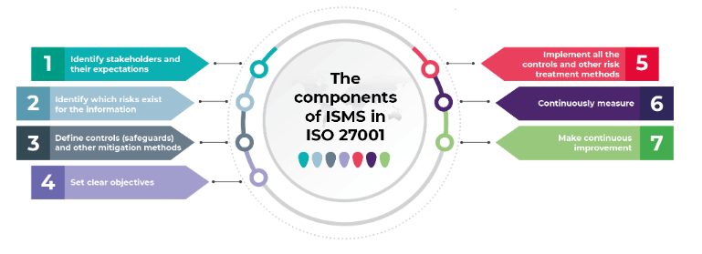
What is ISO 27001 information security management?
ISO/IEC 27001 is the international standard for information security. It sets out the specification for an effective ISMS (information security management system).
ISO 27001’s best-practice approach helps organizations manage their information security by addressing people, processes and technology.
ISMS: consider ISMS to be a systematic approach for managing and protecting a company’s information
What are the components of ISMS in ISO 27001?
The Information Security Management System represents a set of policies, procedures, and various other controls that set the information security rules in an organization. Holistically, the objectives of these components include the following:
identify stakeholders and their expectations of the company in terms of information security
identify which risks exist for the information
define controls (safeguards) and other mitigation methods to meet the identified expectations and handle risks
set clear objectives on what needs to be achieved with information security
implement all the controls and other risk treatment methods
continuously measure if the implemented controls perform as expected
make continuous improvement to make the whole ISMS work better

Slide 3
ISO 27701 – 14 Control sets, 114 control points
Annex A.5 – Information security policies (2 controls)
Annex A.5 ensures policies are written and reviewed in line with the organization's information security practices.
Annex A.6 – Organization of information security (7 controls)
This annex covers the assignment of responsibilities for specific tasks. It’s divided into two sections.
Annex A.6.1 ensures that the organisation has established a framework that can adequately implement and maintain information security practices.
Annex A.6.2 addresses mobile devices and remote working. It’s designed to ensure that anyone who works remotely follows appropriate practices.
Annex A.7 – Human resource security (6 controls)
The objective of Annex A.7 is to make sure that employees and contractors understand their responsibilities.
It’s divided into three sections:
Annex A.7.1 addresses individuals’ responsibilities before employment.
Annex A.7.2 covers their responsibilities during employment.
Annex A.7.3 addresses their responsibilities when they no longer hold that role because they’ve left the organization or changed positions.
Annex A.8 – Asset management (10 controls)
This annex concerns the way organizations identify information assets and define appropriate protection responsibilities.
It contains three sections. Annex A.8.1 is primarily about organizations identifying information assets within the scope of the ISMS.
Annex A.8.2 is about information classification. This process ensures that information assets are subject to an appropriate level of defense.
Annex A.8.3 is about media handling, ensuring that sensitive data isn’t subject to unauthorized disclosure, modification, removal or destruction.
Annex A.9 – Access control (14 controls)
The aim of Annex A.9 is to ensure that employees can only view information that’s relevant to their job.
It’s divided into four sections, and addresses (1) the business requirements of access controls, (2) user access management, (3) user responsibilities, and (4) system and application access controls.
Annex A.10 – Cryptography (2 controls)
This annex is about data encryption and the management of sensitive information. Its two controls ensure that organisations use cryptography effectively to protect data confidentiality, integrity and availability.
Annex A.11 – Physical and environmental security (15 controls)
This annex addresses the organization's physical and environmental security. It’s the most extensive annex in the Standard, containing 15 controls separated into two sections.
Annex A.11.1 works to protect premises and sensitive data from unauthorized access, damage, or interference.
Meanwhile, Annex A.11.2 deals specifically with equipment. It’s designed to prevent the loss, damage or theft of an organisation’s information asset containers.
Annex A.12 – Operations security (14 controls)
This annex ensures that information processing facilities are secure and is comprised of seven sections.
Annex A.12.1 addresses operational procedures and responsibilities, ensuring that the correct operations are in place.
Annex A.12.2 addresses malware, ensuring that the organisation has the necessary defences to mitigate infection risk.
Annex A.12.3 covers organisations’ requirements when it comes to backing up systems to prevent data loss.
Annex A.12.4 is about logging and monitoring. It’s designed to make sure that organisations have documented evidence when security events occur.
Annex A.12.5 addresses organisations’ requirements when it comes to protecting the integrity of operational software.
Annex A.12.6 covers technical vulnerability management and is designed to ensure that unauthorised parties don’t exploit system weaknesses.
Finally, Annex A.12.7 addresses information systems and audit considerations. It’s designed to minimise the disruption that audit activities have on operation systems.

Slide 4
ISO 27701 – 14 Control sets, 114 control points
Annex A.13 – Communications security (7 controls)
This annex concerns the way organisations protect the information in networks. It’s divided into two sections.
Annex A.13.1 concerns network security management, ensuring that the confidentiality, integrity and availability of information in those networks remain intact.
Annex A.13.2 covers security when transferring information within or outside the organisation, to customers or other interested parties.
Annex A.14 – System acquisition, development and maintenance (13 controls)
Annex A.14 ensures that information security remains a central part of the organisation’s processes across the entire lifecycle.
Its 13 controls address the security requirements for internal systems and those that provide services over public networks.
Annex A.15 – Supplier relationships (5 controls)
This annex concerns the contractual agreements organisations have with third parties.
It’s divided into two sections. Annex A.15.1 addresses the protection of an organisation’s valuable assets that are accessible to or affected by suppliers.
Meanwhile, Annex A.15.2 is designed to ensure that both parties maintain the agreed level of information security and service delivery.
Annex A.16 – Information security incident management (7 controls)
This annex is about how to manage and report security incidents. It requires organisations to designate certain employees to handle tasks, ensuring that incident response is managed consistently.
Annex A.17 – Information security aspects of business continuity management (4 controls)
The aim of Annex A.17 is to create an effective system to manage business disruptions. It’s divided into two sections.
Annex A.17.1 addresses information security continuity. It outlines the measures that can be taken to ensure that information security continuity is embedded in the organisation’s business continuity management system.
Annex A.17.2 looks at redundancies, ensuring the availability of information processing facilities.
Annex A.18 – Compliance (8 controls)
This annex ensures that organisations identify relevant laws and regulations. This helps them understand their legal and contractual requirements, mitigating the risk of non-compliance and the penalties that come with that.
What are the benefits of ISMS?
Without some kind of a framework, information security becomes unmanageable – this is where ISO 27001 comes in. When you build up your Information Security Management System, which means developing a set of information security rules, responsibilities, and controls, then you’ll be able to manage such a complex system.
Finally, an Information Security Management System is nothing else but several security processes all tied up together – the better these processes are defined, and the better these processes are interrelated, the fewer incidents you will have. Thus, implementing an ISMS assures an effective and beneficial asset to your organization.

Slide 5
What is ISO 27701 privacy information management system ?
ISO 27701 is a privacy extension to ISO 27001, which provides guidelines and requirements for implementing and managing a privacy information management system (PIMS) within an existing Information Security Management System (ISMS).
The ISO/IEC 27701:2019 standard is the first international privacy standard, which
outlines the requirements for implementing a Privacy Information Management
System (PIMS), to govern the handling of personal data, called Personally
Identifiable Information (PII) in ISO 27701.
The purpose of ISO 27701 is to help organizations protect the privacy rights of individuals by providing a systematic approach to managing personal data. It outlines requirements and guidance for implementing privacy controls and managing risks related to personal information, such as collection, use, retention, disclosure, and disposal.
ISO 27701 Compliance provides organization with multiple benefits:
Support compliance to privacy regulations – such as the European Union General Data Protection Regulation (EU GDPR) and local privacy law & regulations such as Personal Data Protection Act (PDPA) in India.
Provide confidence to stakeholders and customers – that you are maintaining the highest standards in managing privacy risks related to PII.
Clear roles & responsibilities – for PII controllers and PII processors holding responsibility and accountability for PII processing.
Minimise risks – of disruptions of critical processes and financial losses associated with a breach.

Slide 6
Achieving ISO 27701 compliance
ISO 27701 compliance involves implementing a Privacy Information Management System (PIMS) that meets the requirements and guidance outlined in the standard. Here are some key steps that organizations can take to achieve compliance with ISO 27701:
Conduct a privacy risk assessment: Identify and evaluate the risks associated with processing personal data, including the likelihood and impact of privacy breaches.
Establish privacy policies and procedures: Develop and implement policies and procedures for managing personal data, including how it is collected, used, stored, disclosed, and disposed of.
Implement privacy controls: Implement appropriate technical, administrative, and physical controls to safeguard personal data and ensure compliance with applicable privacy laws and regulations.
Train employees: Train employees on the organization's privacy policies and procedures, as well as their individual responsibilities for protecting personal data.
Monitor and review: Continuously monitor and review the effectiveness of the PIMS and make improvements as necessary.
Obtain certification: Consider obtaining third-party certification to demonstrate compliance with ISO 27701.
By following these steps, organizations can establish a strong privacy management program that aligns with the requirements of ISO 27701 and helps protect the privacy rights of individuals.

Slide 7
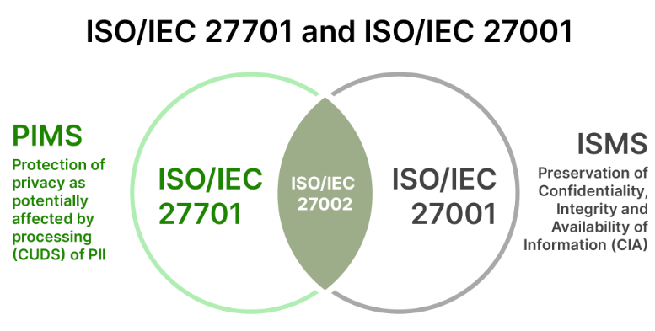
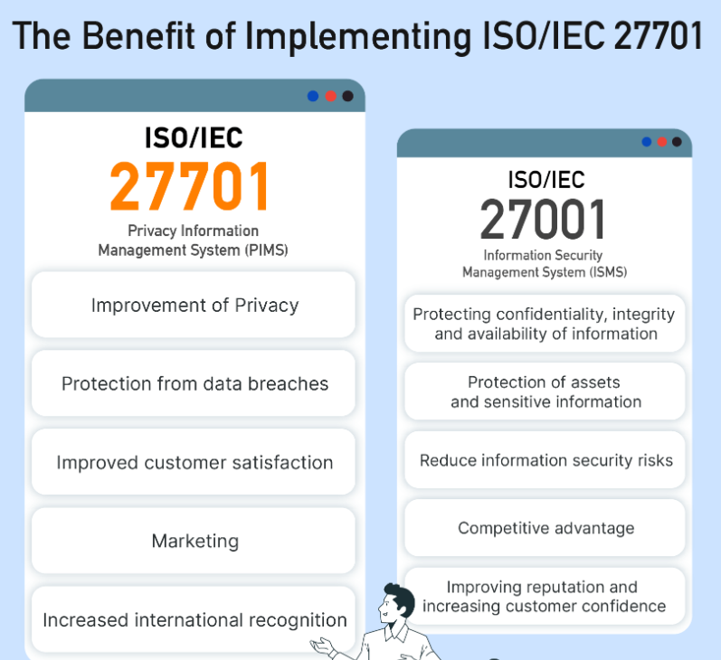
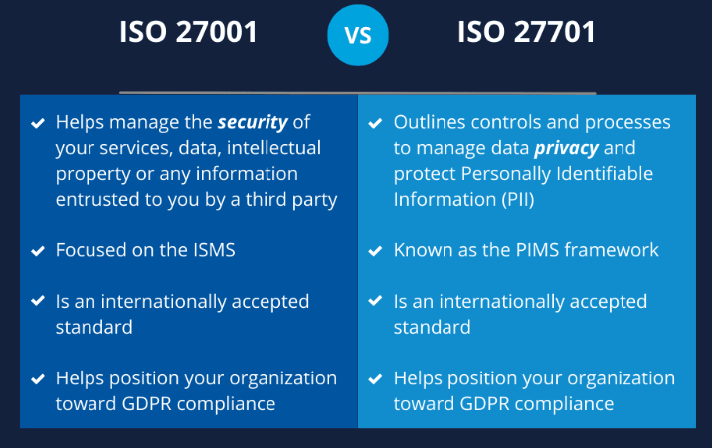
ISO 27001 vs ISO 27701

Slide 8
Links:
https://github.com/nandeesh-kumar/Compliance/tree/main/ISO%2027001-27701
https://issuu.com/public-it/docs/pims-form-05-2_internal_audit_checklist
https://www.smartsheet.com/sites/default/files/2020-06/IC-ISO-27001-Controls-Checklist-10838.xlsx
https://www.halkynconsulting.co.uk/security-resources/downloads/ISO27001-2013-ComplianceChecklist.xlsx
https://www.isms.online/app/uploads/2023/02/ISO-27701-Audit-Roadmap-ISMS.online.pdf
https://advisera.com/27001academy/what-is-iso-27001/

Slide 9
Thanks

